Slide 1


Salient Object Detection (SOD) Project
Mentor: Dafina Berisha
Xponian: Diona Muçiqi
© 2025 Copyright Genpact. All Rights Reserved.

Slide 2
Project Overview
Promblem We Addressed
What the Project Needed
What I Built
What the Project Delivers
Salient Object Detection focuses on identifying the most important object in an image while ignoring the background.Many traditional approaches struggle with accuracy and robustness in real-world images.
A complete end-to-end deep learning pipeline, including:
A reliable SOD dataset (ECSSD)
Strong preprocessing & augmentation
A custom CNN architecture built from scratch
Correct training, evaluation, and visualization steps
A custom encoder–decoder CNN for saliency prediction. A full TensorFlow data pipeline (load → resize → normalize → augment). A full training and testing setup. Evaluation and Visualizations tools.
A working SOD model capable of detecting main objects. Quantitative metrics for objective evaluation. Clear visual results for interpretation. Report + PowerPoint + GitHub repo

Slide 3
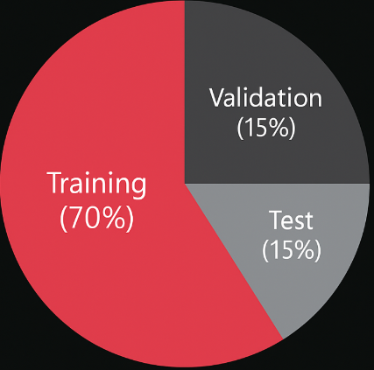
Dataset & Preprocessing
Dataset Overview
ECSSD dataset with high-quality saliency masksContains diverse natural scenes and objectsImages paired automatically using filename matching
Preprocessing Steps
Resize all images & masks to 224×224
Normalize pixel values to 0–1
Convert masks to single-channel format
Data Augmentation
Horizontal flip
Brightness adjustment
Random crop (90%) + resize
Applied only to training set
Training Set (70%)
Validation Set (15%)
Test Set (15%)

Slide 4
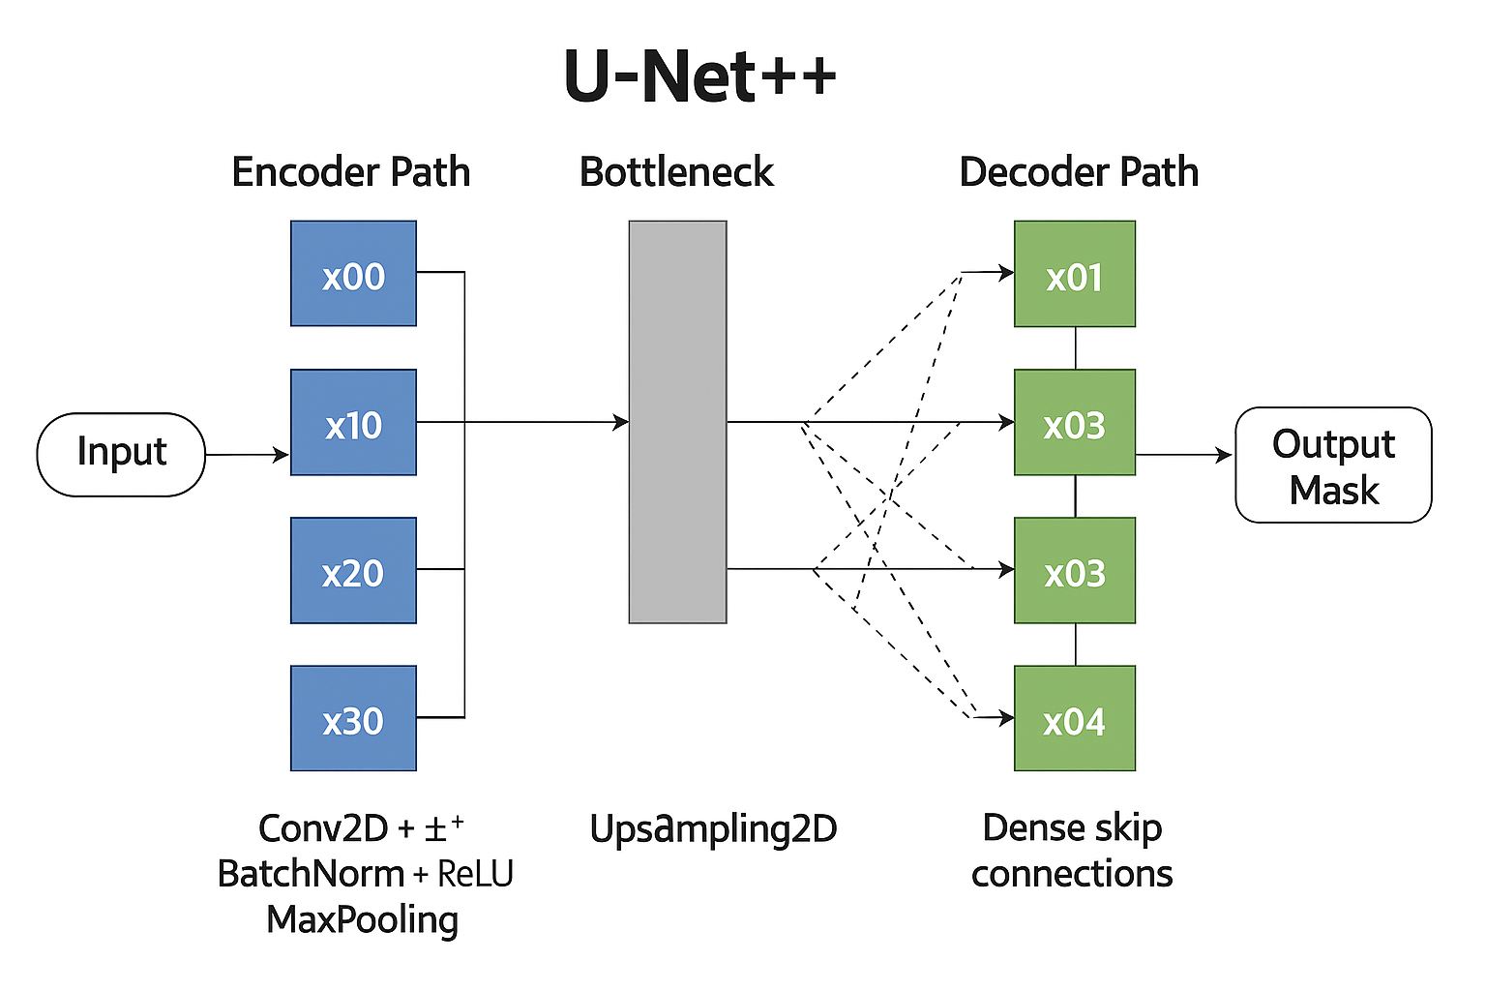
Model Architecture
Multi-scale feature extraction using Conv2D + BN + ReLU blocks.
Bottleneck capturing high-level semantic information
Dense skip connections (U-Net++) for enhanced boundary accuracy
Decoder with upsampling to generate final saliency mask

Slide 5
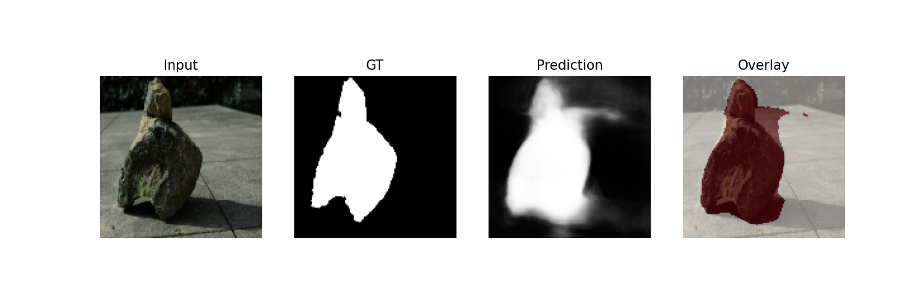
Evaluation & Results
Pixel-level evaluation of model predictions against ground-truth masks
Measures boundary accuracy and quality of salient object extraction
Demonstrates model generalization on unseen test samples

Slide 6


Conclusion
Model Performance
Achieves stable pixel-level segmentation accuracy on the test set.
Generates consistent foreground masks with clear boundary separation.
Technical Insights
Fully custom encoder–decoder CNN implemented end-to-end.
Efficient preprocessing pipeline using tf.data with augmentation.
Metrics (IoU, Precision, Recall, F1) confirm reliable generalization
© 2025 Copyright Genpact. All Rights Reserved.

